Slide 1
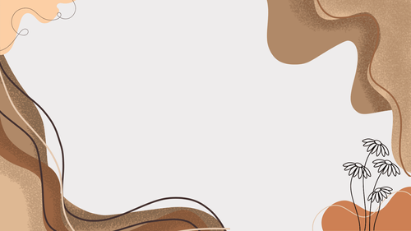
Allomorphs and their Conditions

Slide 2


ACTIVITY: Can you tell?
Identify whether the given letter is voiced or voiceless. Send a clap emoji ( ) if it’s voiced, and thumbs up ( ) if it’s voiceless.
1. v
2. f
3. d
4. w
5. t
-voiced
-voiceless
-voiced
-voiced
-voiceless

Slide 3
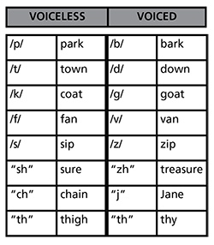

Slide 4
WHAT IS ALLOMORPH?
An allomorph is a variant form of a morpheme that appears in different contexts but retains the same meaning. The choice of an allomorph depends on specific linguistic conditions, such as phonetic environment, grammatical function, or irregular patterns.

Slide 5
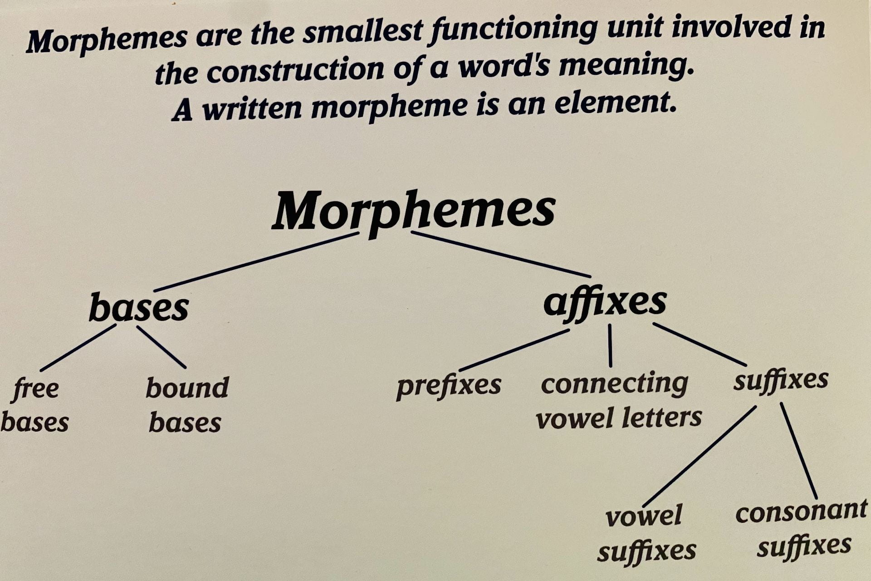

Slide 6
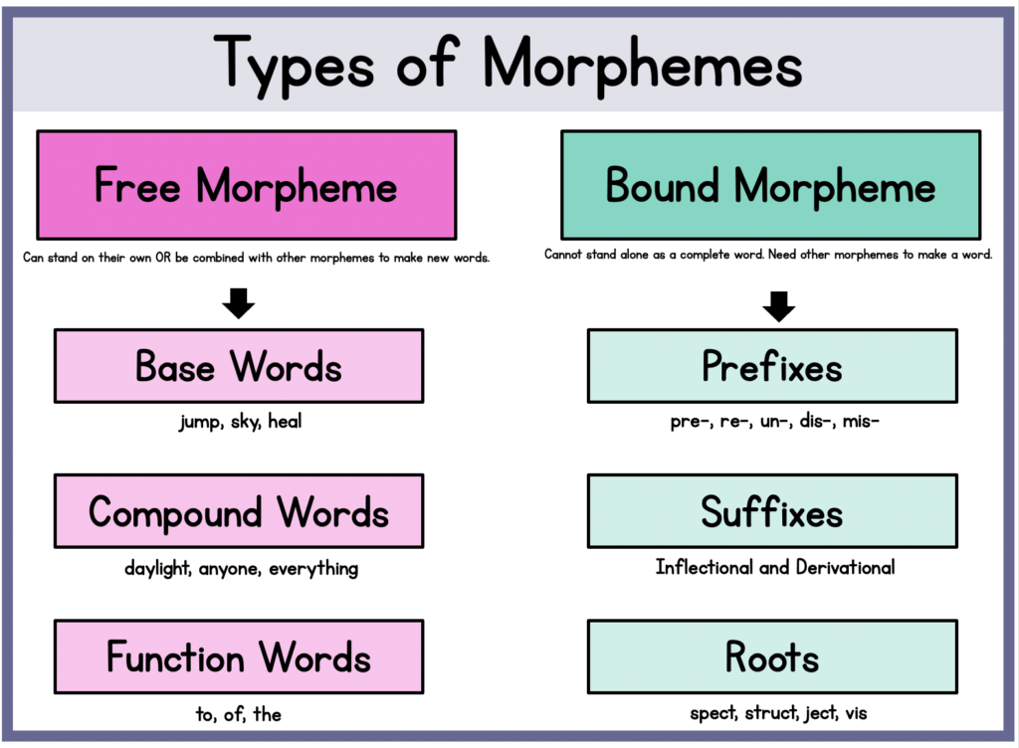

Slide 7
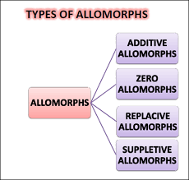

Slide 8
Types of Allomorphs and their Conditions:
1. Additive allomorph
is a morpheme that is added to a word to change its meaning. For example, the suffix "-ed” and suffix“–s”

Slide 9
a. Plural Allomorph
These allomorphs change based on sound rules in a language.
Example: The English plural morpheme "-s" has three allomorphs:
  /s/ - after voiceless sounds
  tips socks
  muffs meets
  books cats

Slide 10
Types of Allomorphs and their Conditions:
Example: The English plural morpheme "-s" has three allomorphs:
  /z/- after voiced sounds
  cars limbs toys
  bugs bids dogs

Slide 11
Types of Allomorphs and their Conditions:
Example: The English plural morpheme "-s" has three allomorphs:
  /ɪz/- after sibilant sounds
            (s, sh, ch, x)
  churches wishes buses
  beaches boxes

Slide 12
b. Past Allomorph
These allomorphs change due to grammatical rules rather than pronunciation.
Example: The English past tense "-ed" has different forms:
  /t/- after voiceless sounds
  slipped walked
  sniffed hissed

Slide 13
b. Past Allomorph
These allomorphs change due to grammatical rules rather than pronunciation.
Example: The English past tense "-ed" has different forms:
  /d/ - after voiced sounds
  toyed stumbled played
  begged famed

Slide 14
b. Past Allomorph
Example: The English past tense "-ed" has different forms:
  /ɪd/ - after "t" or "d”
  painted tended
  listed wounded
  chatted offended

Slide 15
  Let’s practice!
  Provide at least 2 examples of a morpheme.
  Pronounce the following words applying the rules of plural allomorphs.
  puffs kisses amends
  omits teaches brings
  3. Pronounce the following words applying the rules of past allomorphs.
  missed stayed benefited
  recorded lasted sniffed

Slide 16
c. Negation Allomorph
These allomorphs can differ in their pronunciation or spelling, but they all serve the same function of making a word or phrase negative.
The negative morpheme changes the prefix [in] [il] [im] [ir] to the consonant of the word it prefixes:
[il] as in 'illegal’
[im] as in 'impatient’
[ir] as in 'irregular’
[in] as in 'inconsiderate’

Slide 17
Examples of negative allomorphs in English:
in-: This is the most common negative prefix in English. It has several allomorphs, including:
im-: Used before words beginning with "m" or "p" (e.g., "impossible," "immature")
il-: Used before words beginning with "l" (e.g., "illegal," "illogical")
ir-: Used before words beginning with "r" (e.g., "irregular," "irresponsible")

Slide 18
un-: This prefix is used to negate adjectives and some verbs (e.g., "unhappy," "undo").
dis-: This prefix is used to negate verbs and some nouns (e.g., "disagree," "disbelief").
non-: This prefix is used to negate nouns and adjectives (e.g., "nonfiction," "nonstop").
a-: This prefix is used in a few words, such as "asymmetrical" and "amoral."

Slide 19
2. Replacive Allomorph
is a sound that replaces another sound in a word to indicate a difference in meaning.
For example, the /Ι/ in "drink" is replaced by the /æ/ in "drank" to indicate the past tense.
man- men sing-sang
woman-women break-broke

Slide 20
3. Suppletive Allomorphs
These occur when an entirely different word form is used instead of a regular morpheme.
Example:
  go → went → gone (past tense of "go")
  good → better → best (comparative & superlative forms.

Slide 21
4. Zero Allomorph
is a morpheme that is represented by the absence of a phonetic form. It's also known as a null allomorph, zero morph, or zero bound morpheme.
Examples:
noun- sheep, deer
verb- cut, put

Slide 22
  Let’s practice!
  1. Negate the following by adding the appropriate allomorph.
  advantage verbal
  literate moral
  2. Provide the replacive form of the following allomorphs.
  mouse blood
  bring ring
  3. Provide the suppletive form of the given allomorph.
  bad

Slide 23
  Question:
  How do allomorphs in English reflect phonological rules?
  By changing their form based on the sounds around them, particularly in terms of the final sound of a word or the structure of the word. These changes occur to make pronunciation easier or more fluid in different linguistic contexts.

Slide 24
  Thank you
  for listening ☺

