Slide 1
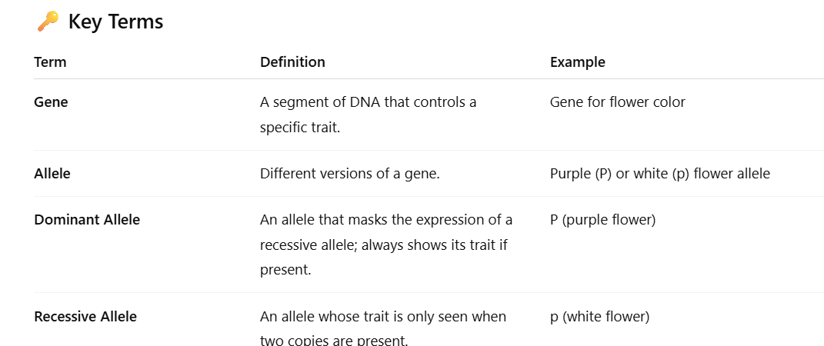
Mendelian Inheritance

Slide 2
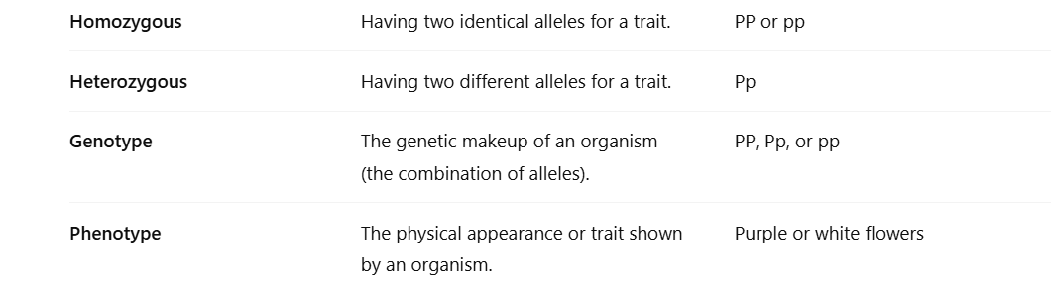
Mendelian Inheritance

Slide 3
Mendel’s Law of Dominance and Recessiveness
Who was Gregor Mendel?
Gregor Mendel, the “Father of Genetics,” studied how traits are inherited in pea plants. Through his experiments, he formulated key principles of heredity, including the Law of Dominance and Recessiveness.

Slide 4
The Law of Dominance and Recessiveness?
When an organism has two different alleles for a trait, one allele (the dominant) can mask the expression of the other (the recessive).
This means that the dominant trait appears in the organism’s physical appearance (phenotype).
The recessive trait is hidden unless the organism inherits two copies of the recessive allele.

