Slide 1
Understanding the Future Continuous Tense

Slide 2
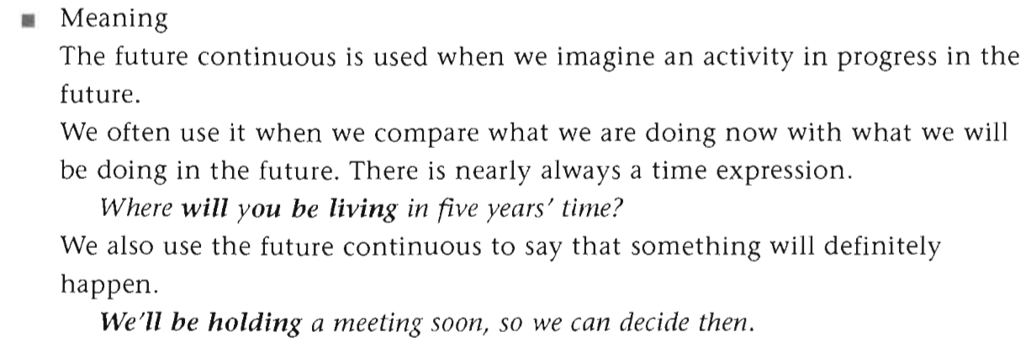

Slide 3
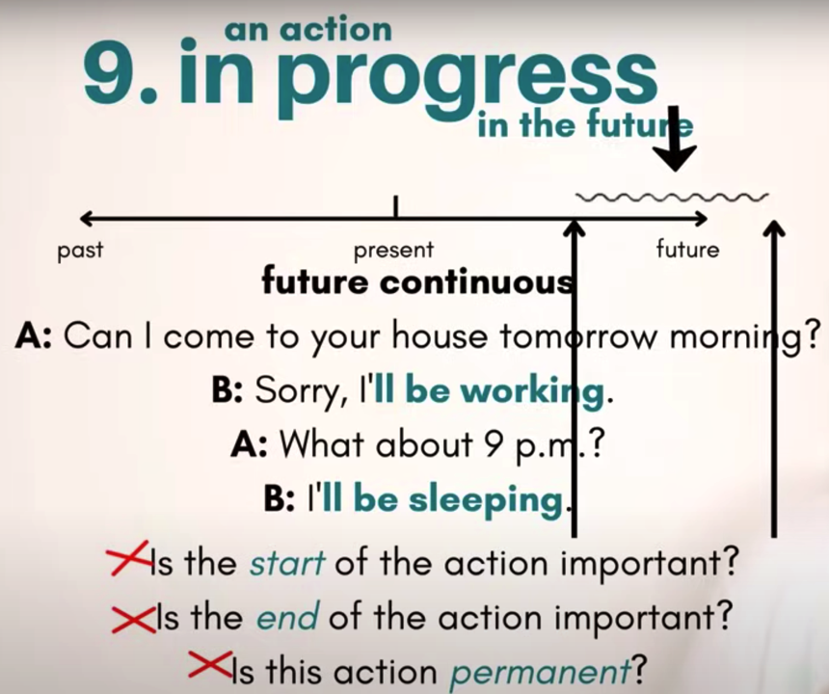

Slide 4
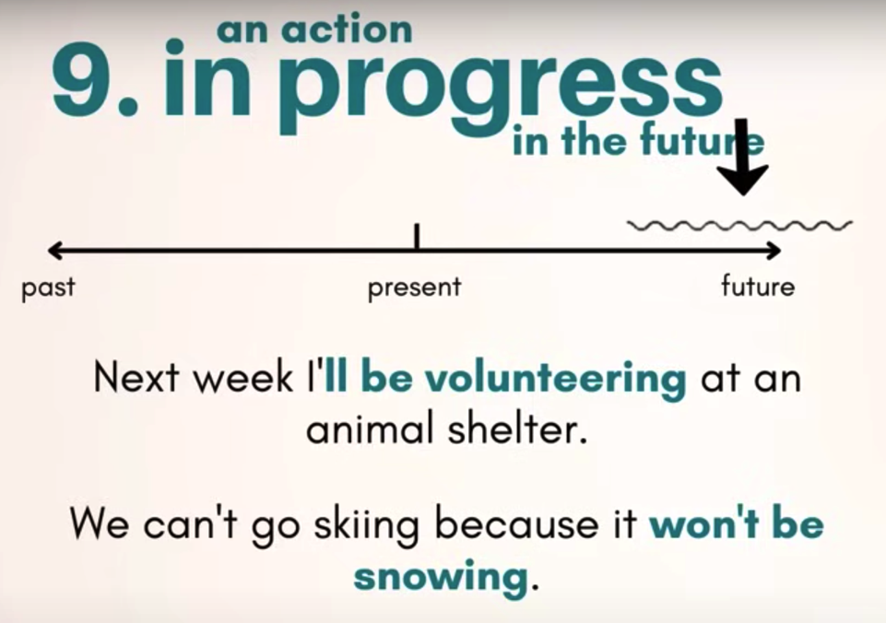

Slide 5
State verbs (again!)
In the meeting we will be
agreeing with each other

Slide 6
negative + again
never again = permanent
Joe was such a rude guest. I won’t be inviting him to my house (ever) again.
I won’t invite him to my house ever again.
Also correct, but slightly different meaning.

Slide 7
questions
polite and formal
Will you be bringing anyone to the dinner tonight?
Will you bring anyone to the dinner tonight?
– also correct, but more straightforward.

Slide 8
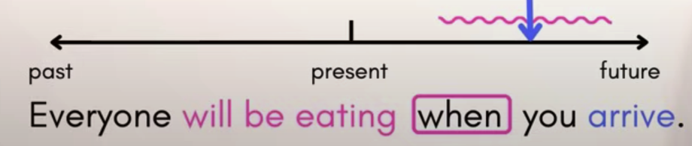
interruptions
I’ll (I will) be waiting when he comes.
future continuous + present simple

Slide 9
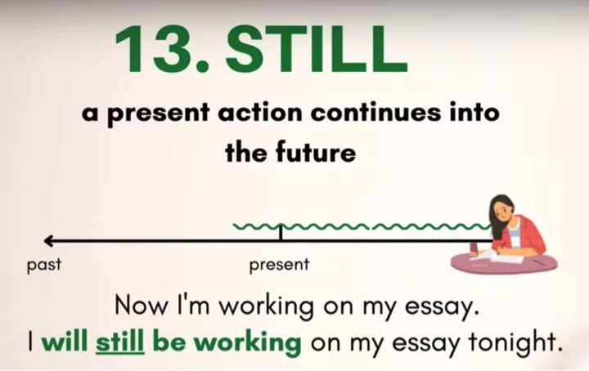

Slide 10
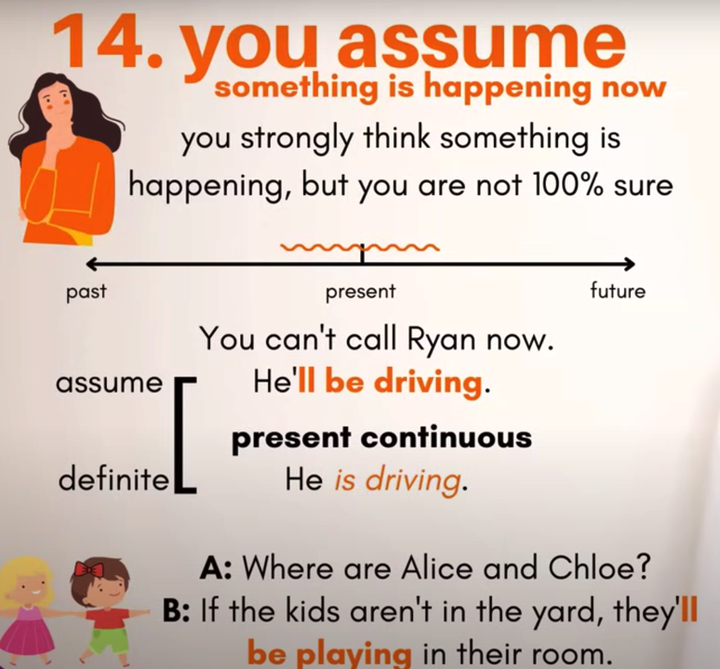

Slide 11


Difference between ‘island’ and ‘Iceland’.
island (a piece of land) –
the ‘s’ is silent.
Iceland (the country) –
the same pronunciation like: ice, ice cream etc.

