Slide 1








BUSINESS ENGLISH FOR FINANCE
(BANKING FOCUS)
Presented by Rostum Baua

Slide 2

COURSE PURPOSE
This course is designed to meet the needs of a banking professional who wants to specialize in Business English for Finance. The lessons focus on real-life banking situations such as client meetings, financial reporting, compliance discussions, loan negotiations, and professional correspondence.

Slide 3
LEARNING OBJECTIVES
By the end of this course, the student will be able to:
  Communicate confidently in banking and financial contexts
  Use appropriate financial and banking vocabulary
  Conduct professional meetings and client consultations
  Write and respond to emails, reports, and proposals in finance
  Use polite and formal English suitable for banking environments
  Explain financial products, risks, and compliance issues clearly

Slide 4

Lesson 1: Professional Banking Introduction

Slide 5
Sample Formal Introduction
“Good morning. My name is [Name], and I work as a banker specializing in financial services. I handle client accounts, financial analysis, loan processing, and compliance with banking regulations. I look forward to working with you today.”
Practice Task
  Introduce your role, department, and responsibilities in a bank
  Explain the type of clients you handle

Slide 6
Lesson 2: Essential Banking & Finance Vocabulary

Slide 7
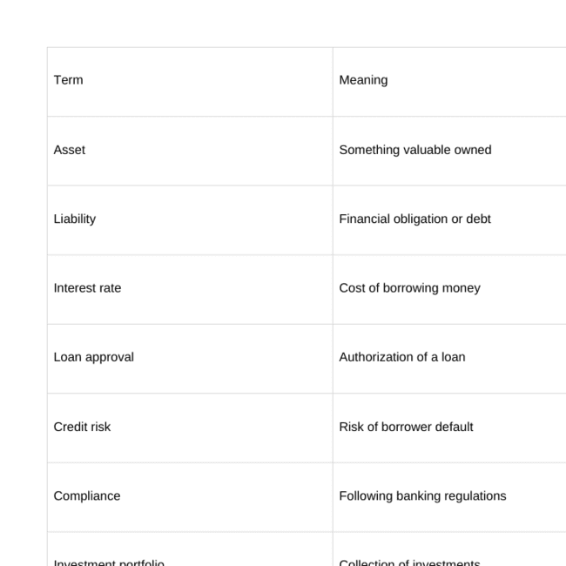

Slide 8
Lesson 3: Banking Meetings & Client Communication

Slide 9
Useful Phrases
  “I would like to explain our financial products.”
  “Could you clarify your investment goals?”
  “May I recommend a suitable loan option?”
  “We need to comply with regulatory requirements.”
Role-Play
Scenario: Meeting a client applying for a business loan
  Ask about financial background
  Explain loan terms and conditions politely

Slide 10
Lesson 4: Polite & Professional Banking Language

Slide 11
Polite Requests
  “Could you please submit the required documents?”
  “Would you mind reviewing the loan agreement?”
  “May I follow up on your application status?”
Direct vs Professional
❌ “Send the documents today.”
✅ “Could you please send the documents today?”

Slide 12
Lesson 5: Financial Reports & Presentations

Slide 13
Key Vocabulary
  Revenue
  Profit margin
  Cash flow
  Financial performance
  Risk assessment
Practice Task
  Explain a simple financial report
  Summarize quarterly performance in clear English

Slide 14
Lesson 6: Banking Emails & Written Communication

Slide 15
Sample Email Opening
“Dear Mr. Santos,\n\nI am writing to follow up on your loan application and to request additional financial documents.”
Practice
  Write a follow-up email to a client
  Respond to a compliance request

Slide 16
Lesson 7: Compliance & Ethical Communication

Slide 17
Importance in Banking
Compliance and ethical communication are critical skills for bankers. Clear and accurate English is required to avoid legal issues, financial risks, and misunderstandings with clients and regulators.
Key Topics
  Anti-Money Laundering (AML)
  Know Your Customer (KYC)
  Regulatory reporting
  Ethical client communication
  Data privacy and confidentiality

Slide 18
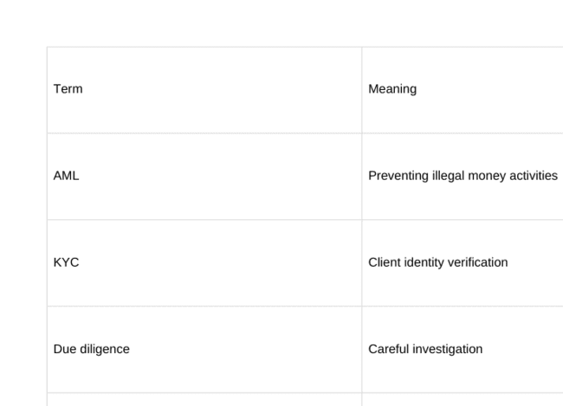
Essential Vocabulary

Slide 19
thank
you

