Slide 1
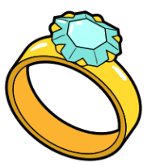
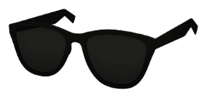
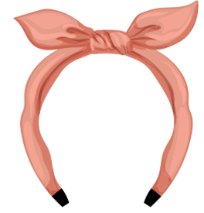
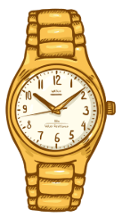
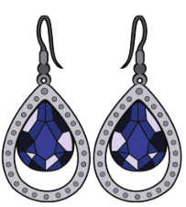
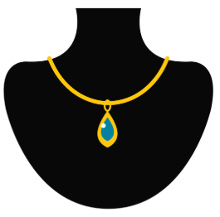
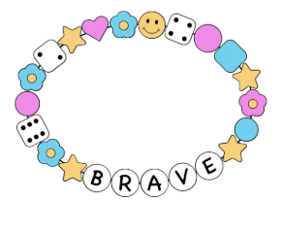
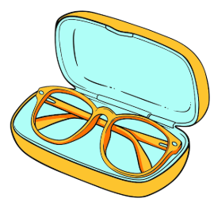
Accessories

Slide 2
Vocabulary
Accessories
a watch

Slide 3
Vocabulary
Clothing
a ring

Slide 4
Vocabulary
Clothing
a headband

Slide 5
Vocabulary
Clothing
a necklace

Slide 6
Vocabulary
Clothing
a bracelet

Slide 7
Vocabulary
Clothing
sunglasses

Slide 8
Vocabulary
Clothing
earrings

Slide 9
Vocabulary
Clothing
eyeglasses

Slide 10

Vocabulary
Colors
gold

Slide 11

Vocabulary
Colors
silver

Slide 12
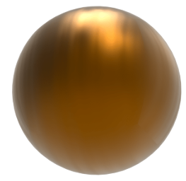
Vocabulary
Colors
bronze

Slide 13
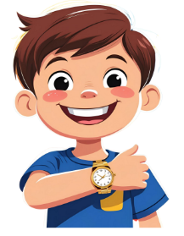
Structure:
Q: What accessory are you wearing?
A: I’m wearing a gold watch.

Slide 14

Structure:
Q: What accessory is he wearing?
A: He’s wearing a silver necklace.

Slide 15
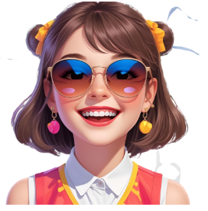
Structure:
Q: What accessories is she wearing?
A: She’s wearing sunglasses.

