Slide 1
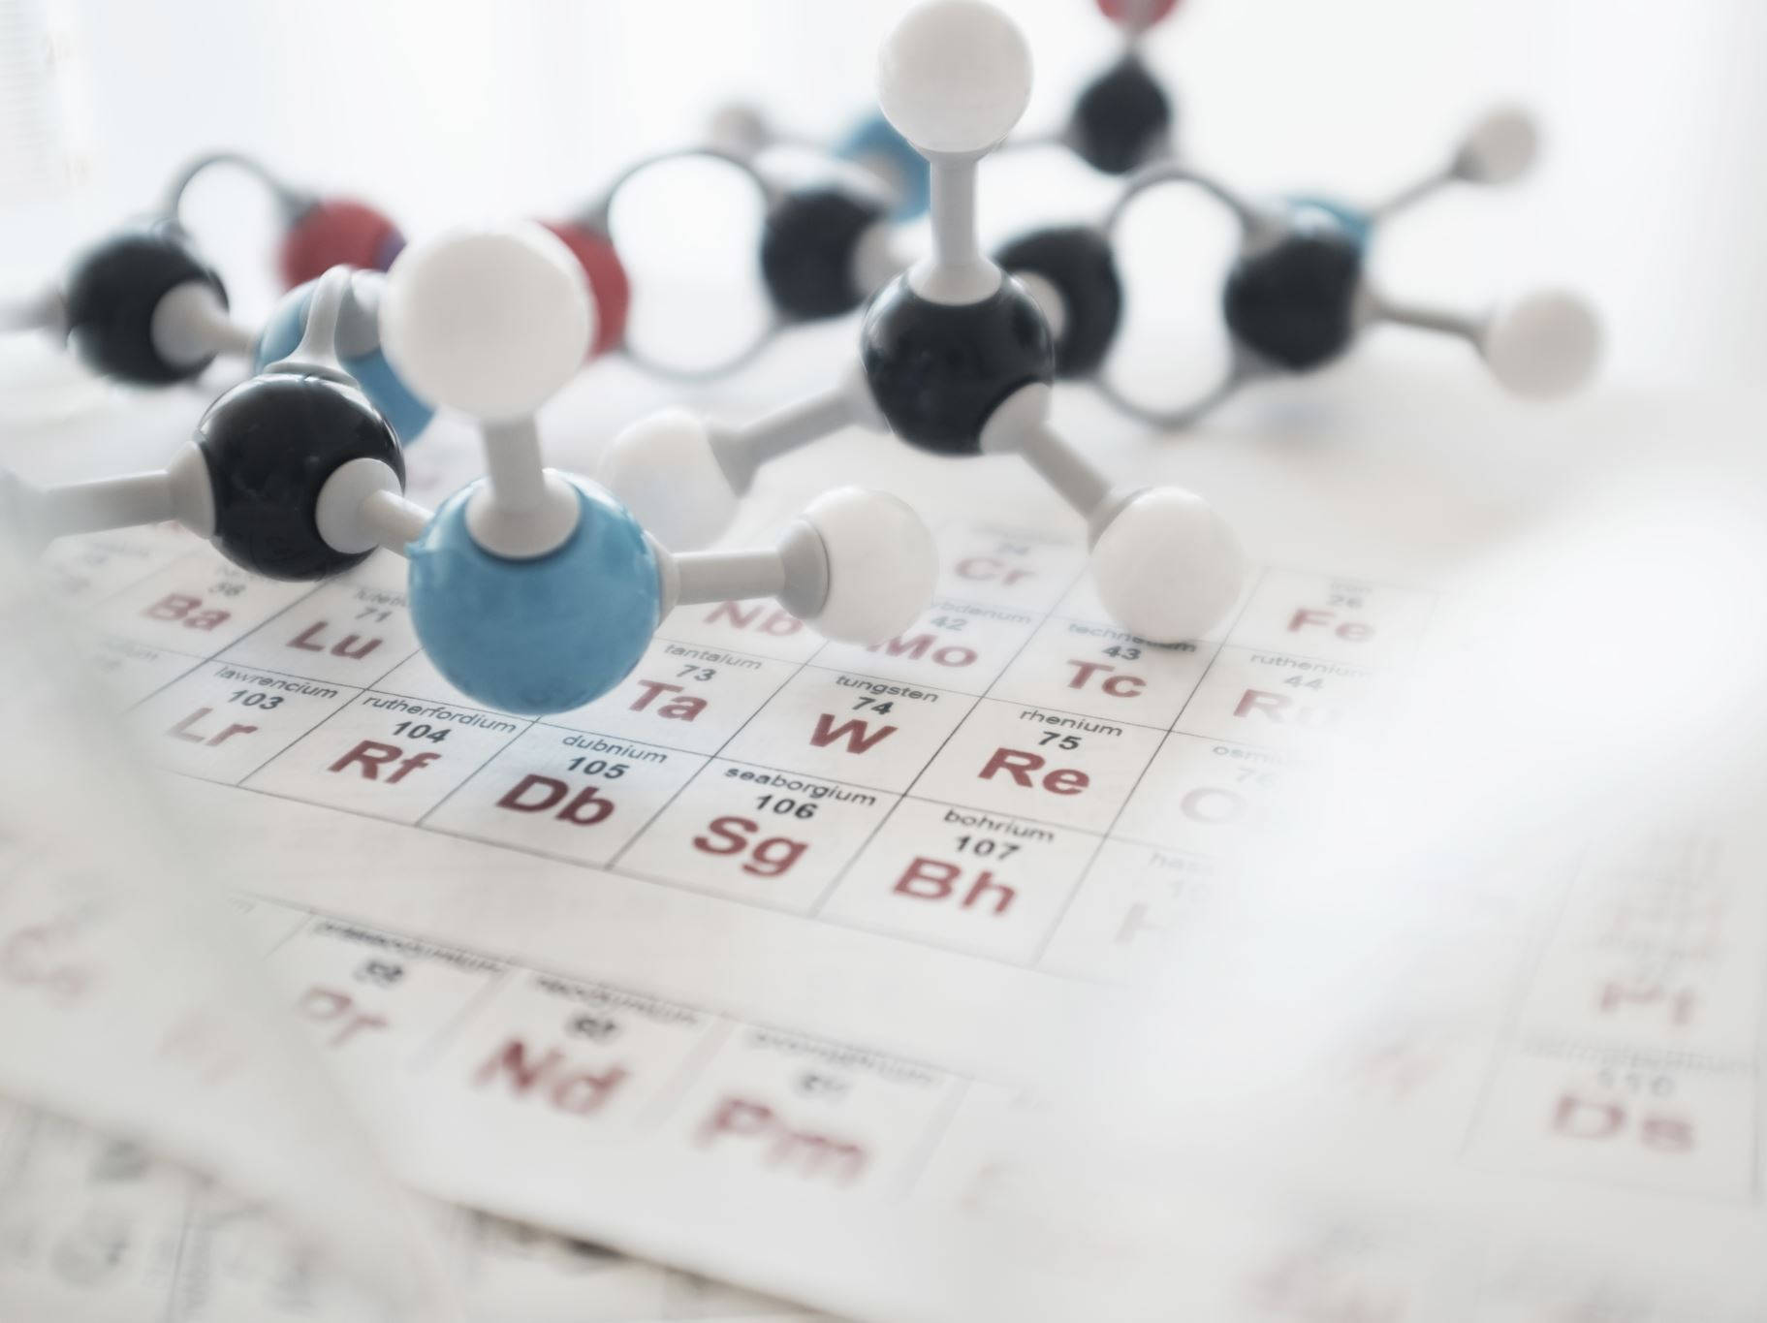
DNA Decoded
Your Ultimate Genetics 101 Exam Prep Guide 📚🔬

Slide 2
What Is DNA, Anyway?
• DNA = Deoxyribonucleic Acid
• Blueprint of life—holds instructions for building proteins
• Location: Mostly in the nucleus (some in mitochondria)
• Function: Stores and transmits genetic information
• Fun Fact: DNA in one cell = ~6 feet long if stretched out!

Slide 3
DNA = Recipe Book
• DNA is like an instruction manual
• Genes = Recipes for traits or proteins
• Proteins control biological functions
• Passed on during cell division and reproduction

Slide 4
DNA’s Structure – The Double Helix
• Double helix shape discovered by Watson & Crick in 1953
• Based on X-ray data by Rosalind Franklin
• Structure is crucial for DNA’s function

Slide 5
Double Helix Details
• Sides = Sugar-phosphate backbone
• Rungs = Nitrogenous bases:
- A pairs with T
- G pairs with C
• Base pairing allows accurate copying

Slide 6
Base Pairing Rules
• A-T has 2 hydrogen bonds; G-C has 3
• Strands are antiparallel (5’ → 3’, 3’ → 5’)
• Directionality matters during replication

Slide 7
DNA Replication – Overview
• Happens during S phase of the cell cycle
• DNA must be copied before a cell divides
• Ensures genetic info is passed to new cells

Slide 8
Step 1 – Unzipping
• Helicase breaks hydrogen bonds between bases
• Creates a replication fork (Y-shaped structure)
• Exposes strands to serve as templates

Slide 9
Step 2 – Priming
• Primase builds short RNA primers
• DNA polymerase needs a starting point

Slide 10
Step 3 – Synthesis
• DNA polymerase adds nucleotides (5’ → 3’ direction)
• Leading strand = continuous
• Lagging strand = Okazaki fragments
• Ligase joins fragments

Slide 11
Step 4 – Proofreading
• DNA polymerase checks and corrects errors
• Ensures replication accuracy (~1 error per billion bases)

Slide 12
Enzymes to Know
• Helicase – Unwinds DNA
• Primase – Adds primers
• DNA polymerase – Builds new strand
• Ligase – Joins Okazaki fragments

Slide 13
Exam Tip!
💡 Be able to explain replication in 3–4 steps:
1. Unzipping
2. Priming
3. Synthesis
4. Proofreading
Use keywords and keep it clear!

Slide 14
Coming Up Next...
DNA vs RNA – The Sibling’s Rivalry 🎬
Stay tuned!

