Slide 1
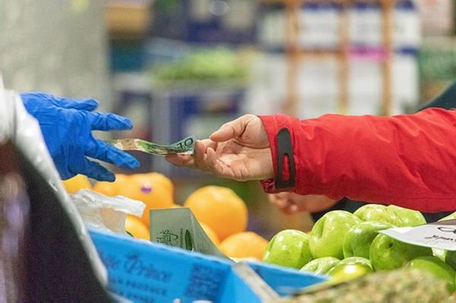
Unit 1: What are Businesses and the Economic Problem....
Businesses provide goods and services to the market, acting as suppliers of both tangible products (goods) and intangible services.
Business Role: Businesses act as suppliers of goods and services.
Goods and Services: Businesses provide both tangible goods and intangible services.
By Mr. Mathew J. Walters

Slide 2
Aims & Objectives
Business objectives are specific, measurable, and actionable targets that guide a company towards
achieving its overall goals. They serve as a roadmap for employees, providing clear steps to follow and ensuring
everyone is working towards the same outcomes.
What they are:
Specific: Clearly define what the business wants to achieve (e.g., increase website traffic, reduce expenses).
Measurable: Establish how success will be tracked (e.g., increase website traffic by 10%).
Actionable: Outline the concrete steps needed to achieve the objective.
Relevant: Ensure the objective aligns with the overall business strategy and goals.
Time-bound: Set a clear deadline for achieving the objective.
SMART - System
By Mr. Mathew J. Walters

Slide 3
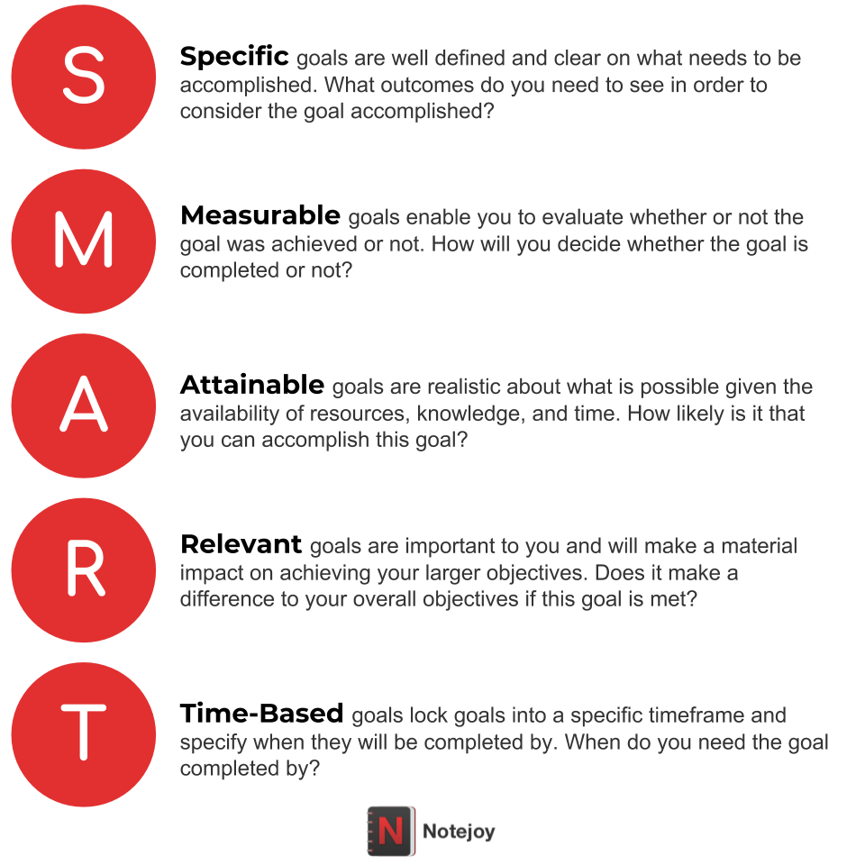
Purpose...
SMART Systems matters...
Why they matter:
Guide decision-making: Objectives help businesses focus their efforts and allocate resources effectively.
Improve performance:
Measurable objectives provide a benchmark for tracking progress and identifying areas for improvement.
Enhance communication:
Objectives ensure everyone is aligned and working towards the same goals.
Drive innovation:
Achieving ambitious objectives can lead to new ideas and approaches.
By Mr. Mathew J. Walters

Slide 4
Types of business objectives:
Financial: Increasing profits, reducing costs, improving profitability.
Operational: Improving efficiency, reducing waste, streamlining processes.
Customer: Increasing customer satisfaction, loyalty, and retention.
Marketing: Increasing brand awareness, generating leads, driving sales.
Human Resources: Improving employee morale, reducing turnover, and increasing productivity.
Social: Contributing to the community, promoting sustainability, and ethical business practices.
"Running a business without a plan is like driving without a destination! Agree? Definitely, you will say yes. Business objectives, no doubt, act as a guide for your business, showing you the way to success.
The objectives of a business also help you stay focused and work efficiently. This article is crafted for you to explain what a business objective is, explore some business objectives examples, and highlight the benefits of setting business objectives."
By Mr. Mathew J. Walters

Slide 5
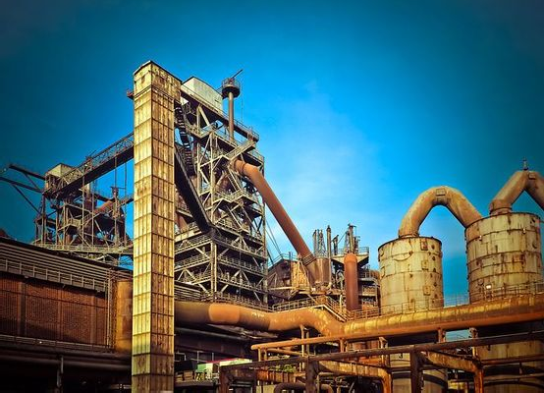
Business Classifications
The different Sectors
Primary, secondary, and tertiary
Businesses are classified into primary, secondary, and tertiary sectors based on their product supply.
Primary business focuses on extracting raw materials like farming, mining, and fishing.
Secondary business involves manufacturing goods from these raw materials, like furniture production or car manufacturing.
Tertiary business provides services, such as retail, healthcare, or entertainment, to consumers and other businesses
By Mr. Mathew J. Walters

Slide 6
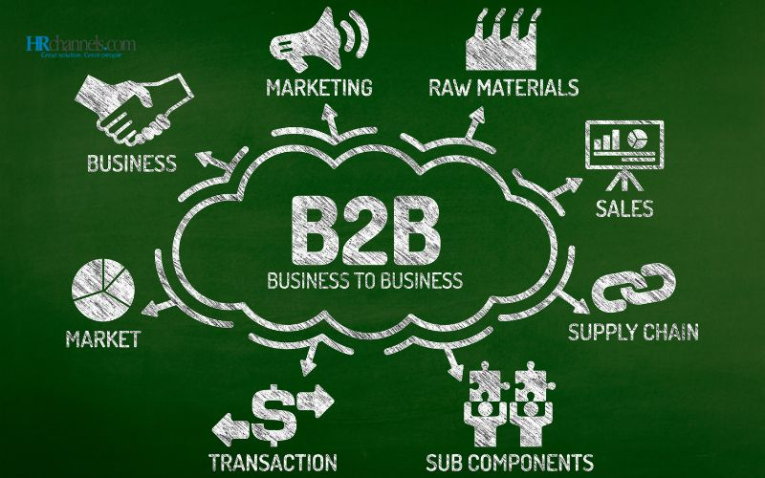
  The Transformation Process
  The B2B-to-B2C transformation process is important because it helps businesses expand their reach to a wider audience and tap into a broader market, potentially leading to increased sales and revenue. This shift also allows businesses to leverage the efficiency and speed of B2C e-commerce while retaining the benefits of B2B relationships.
  Businesses convert inputs (e.g., raw materials) into outputs (finished goods) to meet the needs and desires of other consumers and businesses. This process is known as the transformation process, during which businesses enhance the value of their goods and services.
  Business to Consumer (B2C) Organisations
  Some businesses directly sell their goods and services to consumers, making them business to consumer (B2C) organisations. For instance, Spotify provides music streaming services to consumers, demonstrating its status as a B2C organisation.
  Business to Business (B2B) Organisations
  Other businesses sell their goods and services to other businesses, categorised as business to business (B2B) organisations. Hootsuite, for example, sells social media management services to other businesses like Virgin, showcasing its B2B nature.
By Mr. Mathew J. Walters

Slide 7
Key Terms:
Scarcity means resources are limited, but human wants are
unlimited.
“Scarcity means there aren’t enough resources to satisfy everyone’s wants, so
we have to make choices”
• Choices Must Be Made: Because resources are scarce, individuals,
businesses, and governments must make decisions about how to allocate them.
• Opportunity Cost: Choosing one option means giving up another — the next
best alternative is called the opportunity cost.
• Affects Everyone: Scarcity affects consumers (what to buy), producers
(what to make), and governments (how to spend).
By Mr. Mathew J. Walters

Slide 8
Basic Economic Questions: Scarcity leads to three key questions:
• What to produce?
• How to produce?
• For whom to produce?
• No Economy is Free from Scarcity: Even the richest countries must deal
with scarcity because no country has unlimited resources.
• Resource Types: Scarcity applies to land, labour, capital, and enterprise —
the four factors of production.
• Creates the Need for Economic Systems: Different economies (like market,
mixed, and planned economies) are ways to deal with scarcity.
By Mr. Mathew J. Walters

Slide 9
Real-life consequences...
Higher Prices:
When goods like oil, food, or housing are scarce, prices rise,
making them harder
to afford.
• Inequality: Scarcity can make the gap between rich and poor bigger because
not everyone can access limited resources.
• Trade-offs: Governments might have to cut spending in one area (like
healthcare) to fund another (like defence).
Unemployment: Limited resources can slow down production, causing businesses to hire fewer workers
.
By Mr. Mathew J. Walters

Slide 10
Real life consequences...
Innovation: Scarcity can push people and companies to invent new
technologies or find better ways to use limited resources (e.g., renewable energy)
• Global Conflicts: Countries may fight over scarce resources like water, land or minerals.
• Food Shortages: Scarcity of water or farmland can lead to hunger or famine in some regions.
What real-life scarcity examples can we all relate to....?
By Mr. Mathew J. Walters

Slide 11
Here are real-life scarcity examples students can relate to....
Limited Pocket Money:
You can’t buy everything you want, so you have to
choose between, say, new shoes or going out with friends.
Not Enough Time:
You have to pick between studying for an exam or going
to a party because there’s not enough time to do both well.
Popular Event Tickets:
Only a few tickets are available for a concert or
school event, so not everyone who wants to go can get one.
Limited School Resources:
There might be only a few computers or lab
equipment, so students have to share or wait their turn.
• Scholarships and University Places:
Only a small number of students get
accepted into top universities or win scholarships, even though many apply
By Mr. Mathew J. Walters

